Slide 1
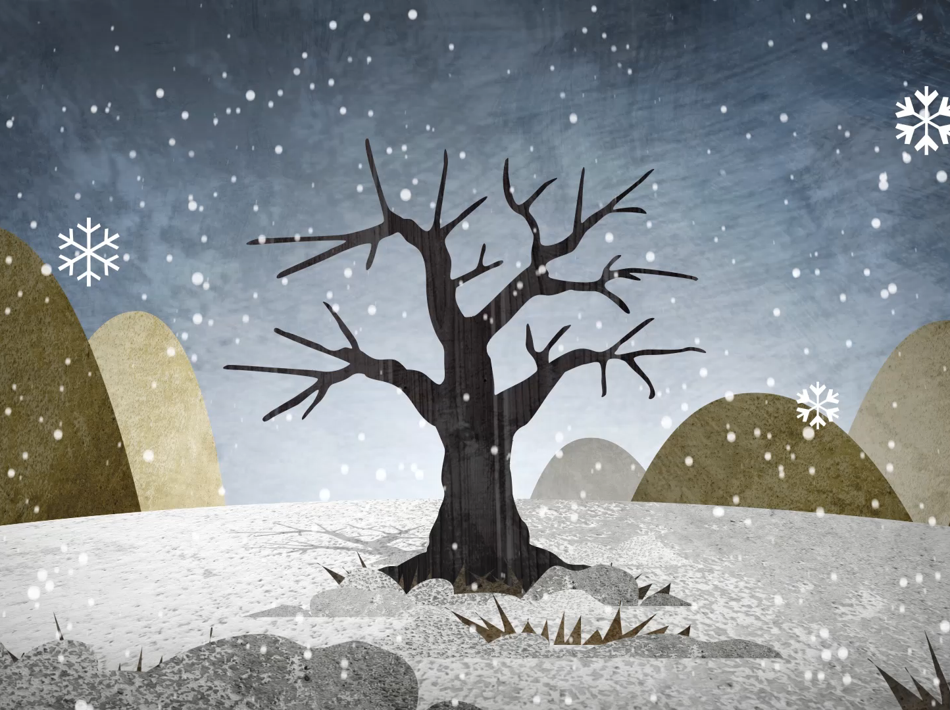
Traversing Binary Trees 2
Unbalanced & incomplete

Slide 2
Prefix: (Root, LEFT, RIGHT)
Root LEFT-subtree RIGHT-subtree
root
8
3 9
6 10
5 7
4

Slide 3
Prefix: (Root, LEFT, RIGHT)
8
Root LEFT-subtree RIGHT-subtree
root
8
3 9
6 10
5 7
4

Slide 4
Prefix: (Root, LEFT, RIGHT)
8
Root LEFT RIGHT
Root LEFT-subtree RIGHT-subtree
root
8
3 9
6 10
5 7
4

Slide 5
Prefix: (Root, LEFT, RIGHT)
8 3
Root LEFT RIGHT
Root LEFT-subtree RIGHT-subtree
root
8
3 9
6 10
5 7
4

Slide 6
Prefix: (Root, LEFT, RIGHT)
8 3
Root LEFT RIGHT
Root LEFT-subtree RIGHT-subtree
root
8
3 9
6 10
5 7
4

Slide 7
Prefix: (Root, LEFT, RIGHT)
8 3 Ro LT RT
Root LEFT RIGHT
Root LEFT-subtree RIGHT-subtree
root
8
3 9
6 10
5 7
4

Slide 8
Prefix: (Root, LEFT, RIGHT)
6
8 3 Ro LT RT
Root LEFT RIGHT
Root LEFT-subtree RIGHT-subtree
root
8
3 9
6 10
5 7
4

Slide 9
Prefix: 5 4
6 rt L R
8 3 Ro LT RT
Root LEFT RIGHT
Root LEFT-subtree RIGHT-subtree
root
8
3 9
6 10
5 7
4

Slide 10
Prefix: 5 4
6 rt L R 7
8 3 Ro LT RT
Root LEFT RIGHT
Root LEFT-subtree RIGHT-subtree
root
8
3 9
6 10
5 7
4

Slide 11
Prefix: 5 4
6 rt L R 7
8 3 Ro LT RT
Root LEFT RIGHT Root LEFT RIGHT
Root LEFT-subtree RIGHT-subtree
root
8
3 9
6 10
5 7
4

Slide 12
Prefix: 5 4
6 rt L R 7
8 3 Ro LT RT 9
Root LEFT RIGHT Root LEFT RIGHT
Root LEFT-subtree RIGHT-subtree
root
8
3 9
6 10
5 7
4

Slide 13
Prefix: 5 4
6 rt L R 7
8 3 Ro LT RT 9
Root LEFT RIGHT Root LEFT RIGHT
Root LEFT-subtree RIGHT-subtree
root
8
3 9
6 10
5 7
4

Slide 14
Prefix: 5 4
6 rt L R 7
8 3 Ro LT RT 9 10
Root LEFT RIGHT Root LEFT RIGHT
Root LEFT-subtree RIGHT-subtree
root
8
3 9
6 10
5 7
4

Slide 15
Prefix: (Root, LEFT, RIGHT)
8 3 6 5 4 7 9 10
Root LEFT-subtree RIGHT-subtree
root
8
3 9
6 10
5 7
4

Slide 16
Infix: (LEFT, Root, RIGHT)
LEFT-subtree Root RIGHT-subtree
root
8
3 9
6 10
5 7
4

Slide 17
Infix: (LEFT, Root, RIGHT)
LEFT Root RIGHT
LEFT-subtree Root RIGHT-subtree
root
8
3 9
6 10
5 7
4

Slide 18
Infix: (LEFT, Root, RIGHT)
LEFT Root RIGHT
LEFT-subtree Root RIGHT-subtree
root
8
3 9
6 10
5 7
4

Slide 19
Infix: (LEFT, Root, RIGHT)
3
LEFT Root RIGHT
LEFT-subtree Root RIGHT-subtree
root
8
3 9
6 10
5 7
4

Slide 20
Infix: (LEFT, Root, RIGHT)
3 LEFT Root RIGHT
LEFT Root RIGHT
LEFT-subtree Root RIGHT-subtree
root
8
3 9
6 10
5 7
4

Slide 21
Infix: 4 5
3 LEFT Root RIGHT
LEFT Root RIGHT
LEFT-subtree Root RIGHT-subtree
L rt R
root
8
3 9
6 10
5 7
4

Slide 22
Infix: 4 5
3 LEFT Root RIGHT
LEFT Root RIGHT
LEFT-subtree Root RIGHT-subtree
L rt R 6
root
8
3 9
6 10
5 7
4

Slide 23
Infix: 4 5
3 LEFT Root RIGHT
LEFT Root RIGHT
LEFT-subtree Root RIGHT-subtree
L rt R 6 7
root
8
3 9
6 10
5 7
4

Slide 24
Infix: 4 5
3 LEFT Root RIGHT
LEFT Root RIGHT 8
LEFT-subtree Root RIGHT-subtree
L rt R 6 7
root
8
3 9
6 10
5 7
4

Slide 25
Infix: 4 5
3 LEFT Root RIGHT
LEFT Root RIGHT 8 LEFT Root RIGHT
LEFT-subtree Root RIGHT-subtree
L rt R 6 7
root
8
3 9
6 10
5 7
4

Slide 26
Infix: 4 5
3 LEFT Root RIGHT 9 10
LEFT Root RIGHT 8 LEFT Root RIGHT
LEFT-subtree Root RIGHT-subtree
L rt R 6 7
root
8
3 9
6 10
5 7
4

Slide 27
Infix: (LEFT, Root, RIGHT)
3 4 5 6 7 8 9 10
LEFT-subtree Root RIGHT-subtree
root
8
3 9
6 10
5 7
4

Slide 28
Postfix: (LEFT, RIGHT, Root) NOW YOU TRY…
LEFT-subtree RIGHT-subtree Root
root
8
3 9
6 10
5 7
4

Slide 29
Postfix: (LEFT, RIGHT, Root) NOW YOU TRY…
4 5 7 6 3 10 9 8
LEFT-subtree RIGHT-subtree Root
root
8
3 9
6 10
5 7
4

